Slide 1
Introduction

Slide 2
The concept of Fuzzy Logic was conceived by Lotfi Zadeh, a professor at the University of California at Berkley in 1965.
It was presented not as a control methodology, but as a way of processing data by allowing partial set membership rather than crisp set membership or non-membership.
Professor Zadeh reasoned that people do not require precise, numerical information input, and yet they are capable of highly adaptive control.

Slide 3
If feedback controllers could have been programmed to accept noisy, imprecise input, they would have been much more effective and perhaps easier to implement.
Unfortunately, U.S. manufacturers have not been so quick to embrace this technology while the Europeans and Japanese have been aggressively building real products around it.
.

Slide 4
What is Fuzzy Logic
It is a generalization of classical logic which manifests in crisp quantities.
It represents concepts with unclear boundaries.
Crisp logic deals with crisp sets having sharp boundaries. The inherent logic is Boolean in nature (i.e. either TRUE or FALSE).
Fuzzy logic deals with fuzzy sets having indistinct boundaries. The inherent logic is multivalued in nature.

Slide 5
What is Fuzzy Logic
In essence, fuzzy logic (FL) is focused on modes of reasoning which are approximate rather than exact.
Fuzzy logic is aimed at precisiation of approximate reasoning
In fuzzy logic, everything, including truth, is or is allowed to be a matter of degree
Fuzzy logic has been and still is, though to a lesser degree, an object of controversy and debate
For the most part, the controversies are rooted in misperceptions, especially a misperception of the relation between fuzzy logic and probability theory

Slide 6
What is Fuzzy Logic
Consider the temperature on a sunny day.
It can either be represented in terms of temperature values e.g. 20⁰-25⁰C.
It can also be represented as a “warm” day with temperature, T ∈ [20⁰ 25⁰].
1
1
B(x)
B(x)
0
0
0
20
25
T
0
20
25
T

Slide 7
Concept of Fuzziness
Decreases complexity through abstraction.
Represents vagueness through qualification.
  e.g. it is usually warm in the summer vs. usually 26⁰C.
  e.g. the weather is sunny meaning 0% cloudy? Or 5% cloudy? Or 10% cloudy? If 15% cloudy, then what about 16% or 15.1%?
1
Sunny
Cloudy
1
Sunny
Cloudy
B(x)
Vagueness
B(x)
0
0
0
50%
100%
0
50%
100%

Slide 8
Definitions
Fuzziness measures the degree to which an event occurs, not whether it occurs.
It exists when the law of non-contradiction [A ∩ Ã=Φ] (or the law of excluded middle [A ∪ Ã=U]) is violated.
Fuzziness primarily describes partial truth or imprecision.

Slide 9
Definitions
It means that everything is a matter of degree.
It is a type of deterministic uncertainty and deals with the soft meaning of concepts.
It is related to computing with words, i.e. linguistic variables.

Slide 10
Probability & Fuzzy Logic
IMPERFECTION
UNCERTAINITY
VAGUENESS
Probability Theory
Possibility Theory
Dempster-Shafer
Fuzzy Set Theory

Slide 11
Probability and Fuzzy Logic
1
1
B(x)
B(x)
0
0
0
5
10
0
5
10
Certainty
Vagueness
1
B(x)
0
0
5
10

Slide 12
Probability & Fuzzy Logic
Probability Measure | Membership Function
Calculates the probability that an ill-known variable x ranging on U hits the well-known set A | Calculates the probability of a well-known variable x ranging on U hits the well-known set A
Before an event occurs | After an event occurs
Membership must add to unity (1) or be continuous | Membership may be discrete
Domain is Boolean | Domain is [0.1]

Slide 13
Representation
FL incorporates a simple, rule-based IF X AND Y THEN Z approach to solving a control problem rather than attempting to model a system mathematically.
Terms like
  "IF (process is too cool) AND (process is getting colder) THEN (add heat to the process)"
  or "IF (process is too hot) AND (process is heating rapidly) THEN (cool the process quickly)"
  are used.

Slide 14
HOW DOES FL WORK?
FL requires some numerical parameters in order to operate, such as what is considered significant error and significant rate-of-change-of-error, but exact values of these numbers are usually not critical unless very responsive performance is required in which case empirical tuning would determine them.

Slide 15
Fuzzy Membership
In a crisp set, elements are either strictly contained in the set or are strictly not contained in the set.
For a crisp set C, an element X is related as
C : X ∈ {0,1} implying either acceptance or rejection, i.e., the Dichotomy concept.
A fuzzy set comprises elements with a certain degree of containment in the set, referred to as the membership of that element.
For a fuzzy set F, an element X is related as
F : X ∈ [0, 1] implies relaxed membership.

Slide 16
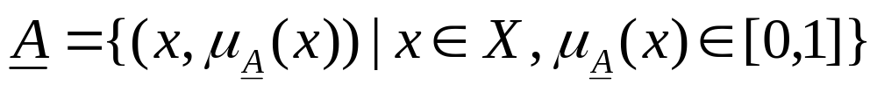
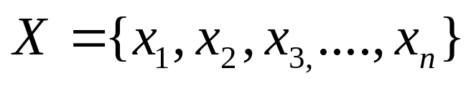
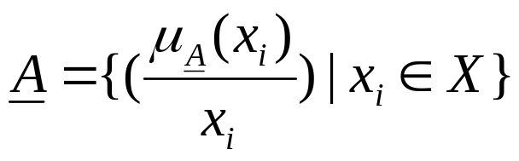
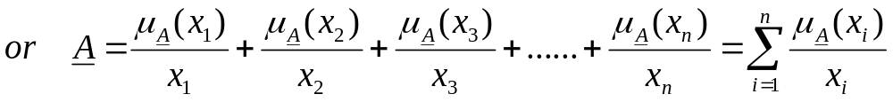
Fuzzy Sets
A fuzzy set is a set of ordered pairs.
Here X is the universe of discourse. It is given by
According to Zadeh’s notation:

Slide 17
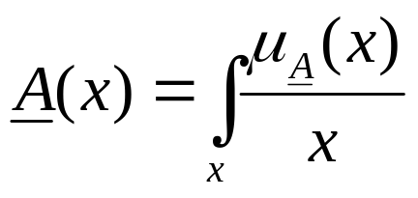

Fuzzy Sets
If X is continuous,
represent the union of membership degrees.
A
x₁
A
x₁
x₂
B
x₂
B
x₃
x₃
x₄
x₄
Crisp Set
Fuzzy Set

Slide 18
Fuzzy Sets - Classic Example
Is half-full
=
half-empty?

Slide 19
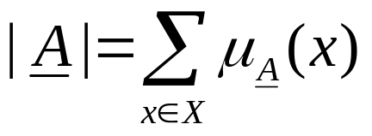
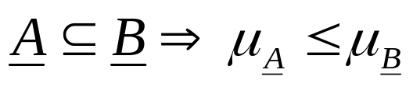
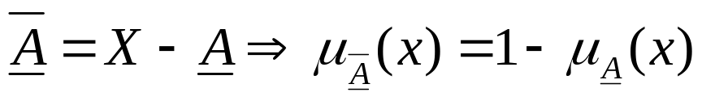
Set Theoretic Operations vis-a-vis the fuzzy sets
Cardinality
Subset
Complement
Union
Intersection

Slide 20
Set Theoretic Operations
B
A
B
A
A in B
A OR B
Not A
A And B

Slide 21




Properties of Fuzzy sets visa-vis classical sets
Commutativity
Idempotency
Associativity
Distributivity
Involution
De Morgan’s Law
Law of absorption

Slide 22
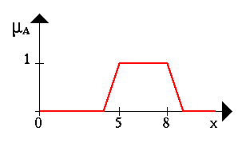
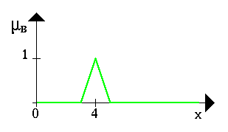
Let A be a fuzzy interval between 5 and 8 and
B be a fuzzy number about 4

Slide 23
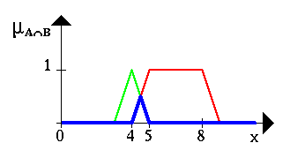
fuzzy set between 5 and 8 AND about 4

Slide 24
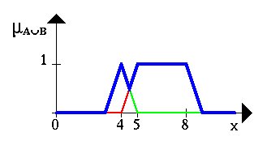
The Fuzzy set between 5 and 8 OR about 4 is shown in the next figure

Slide 25
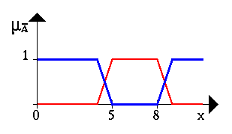
NEGATION of the fuzzy set A

